Slide 1
Certification Management Application
Prepared For
CRM SFDC Training Program
Capgemini Technology Services
Prepared By
Mohit Jain
Emp Id - 46022710

Slide 2
Contents
Introduction
Scope
Object and Fields
Flow of Application
Reports and Dashboard
Validations

Slide 3
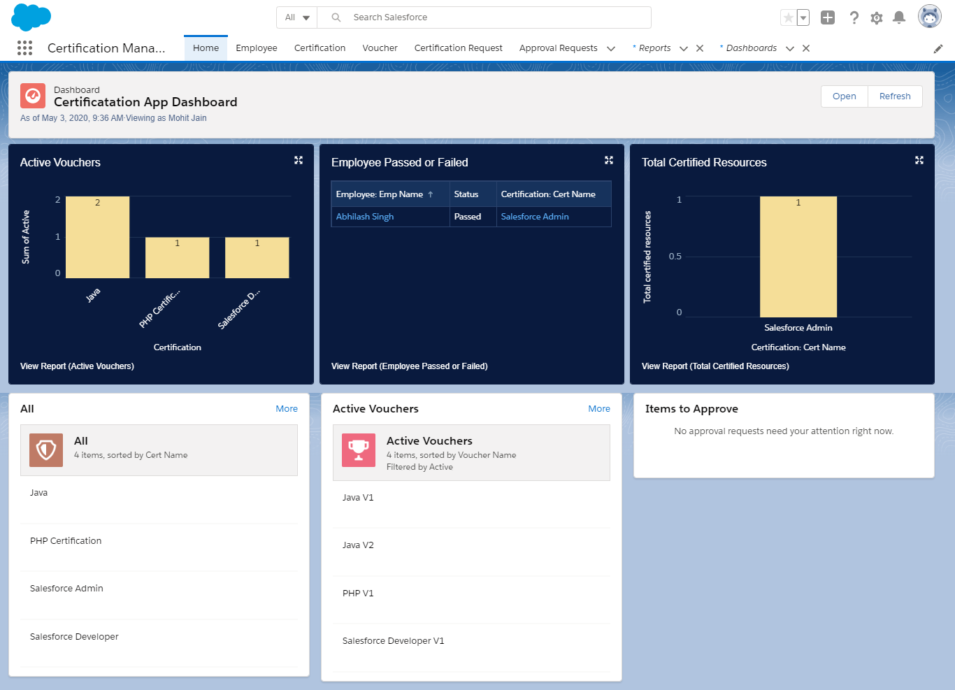
The Certification Management Application is a salesforce-based application for the management of certifications and vouchers. The application is made using the tools such as process builder, approval process, apex triggers provided by salesforce.
The main purpose of this application is to allow the employees of an organisation to request for the certification and the respective voucher easily.
Home Page of the App

Slide 4
Scope
The application is used by 2 types of user:
App Admin - The app admin can:
Create, update and delete Certifications in the system.
Create, update and delete Vouchers in the system.
View all the Certifications requests.
Approve or reject the Certification requests.
Assign Vouchers if a Certification request is approved.
Provide comments if a Certification Requests is rejected.
Manage reports and dashboards.

Slide 5
App Admin - The app user can:
Create, update and delete Employees in the system.
Create and submit certification requests to app admin for approval on behalf of employees requesting for certifications.
View all the Certifications and Vouchers.
Update request status to passed/failed if request is approved.
Manage reports and dashboards.
Notify employee about status of request on every stage.

Slide 6
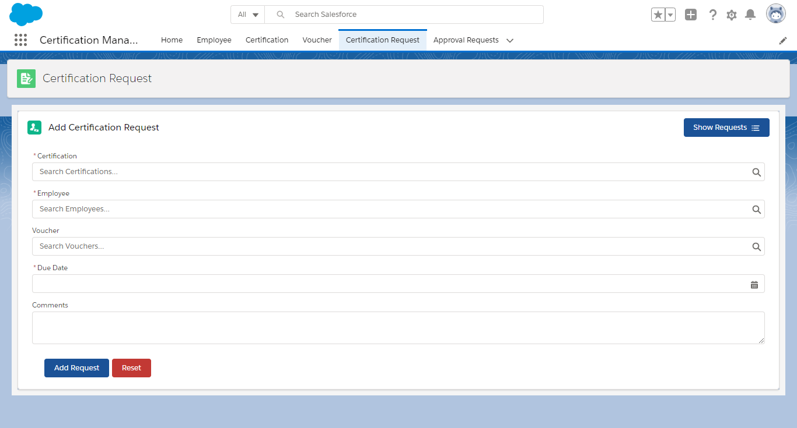
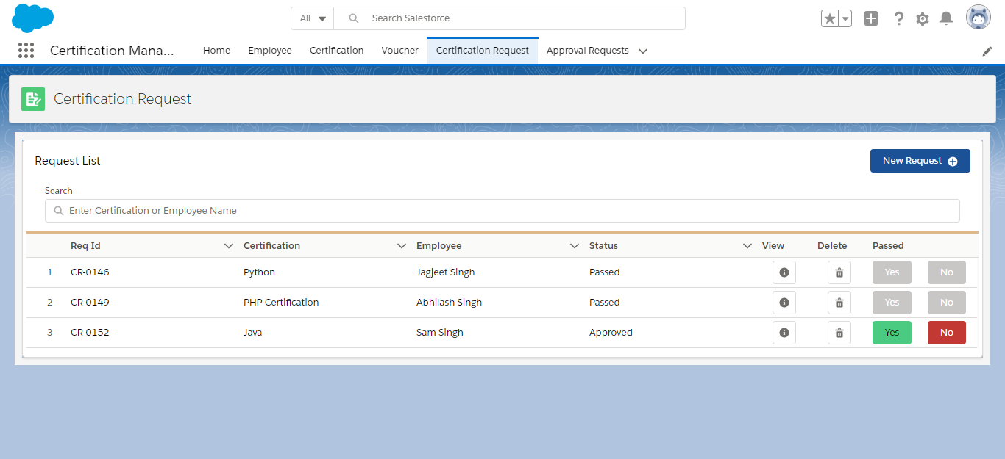
UI for creating Certification request developed using Lightning Web Components
UI for viewing the list request submitted developed using Lightning Web Components

Slide 7
Object | Fields
Employee | Emp ID
 | Emp Name
 | Primary Skill
 | Secondary Skill
 | Experience Comments
Certification | Cert Id
 | Cert Name
 | Comments
Certification Request | Certification (Master-Detail)
 | Employee (Master-Detail)
 | Voucher (lookup) Due Date Status (Picklist) Draft, Approved Rejected Passed Failed Comments
Voucher | Voucher Id
 | Voucher Cost
 | Certification (Lookup)
 | Validity (Date)
 | Active (Boolean- Y/N) Comments
Objects and Fields
The application uses the following 4 custom objects:
Employees
Certifications
Vouchers
Certification Requests

Slide 8
Flow of Application
The App Admin creates certification and voucher records in the system.
Employee mails the app user to issue certification voucher.
App User raises the certification request to the App Admin who in turn approves or rejects the request. The request is raised using Approval Process tool of salesforce. The Approval Process is fired as soon as a request is created.
The Employee is notified when request is submitted by the App User via email.
The App Admin also receives an email when a request is raised.
If the App Admin approves the request, then, the employee and the App User receives a mail to notify them about the approval.
The voucher will be assigned to the user when request is approved.
If the App Admin rejects the request, then, the employee and the App User receives a mail to tell them about the rejection.
The App Admin will provide some comments if the request is rejected.
The employee will notify the App User about the status of certification i.e., the employee passed the certification exam or not after the request is approved.
The App User will then change the request status to Passed/Failed based on the information provided by the employee.
In case due date of request is passed and request is still not approved or rejected, then, the employee and the app user will receive a mail to notify them to update the status of request.
The whole repeats over and over again.

Slide 9
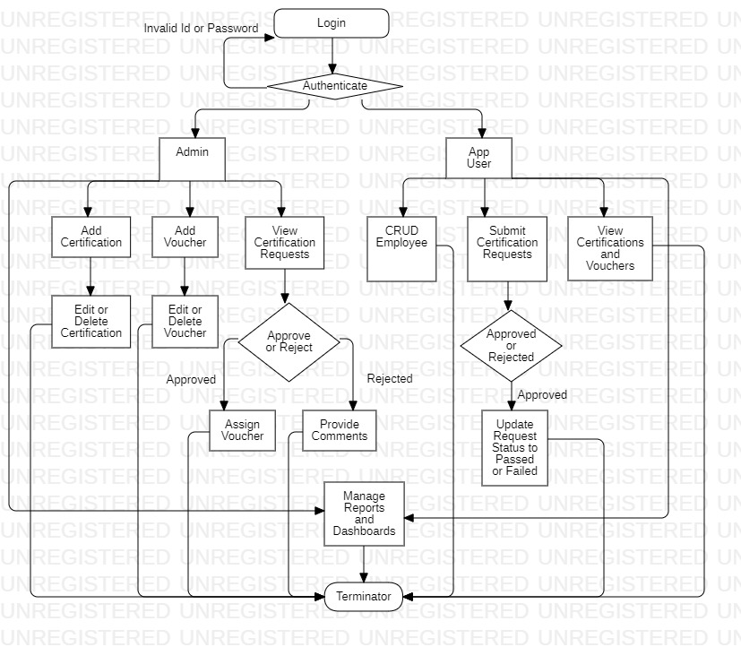

Slide 10
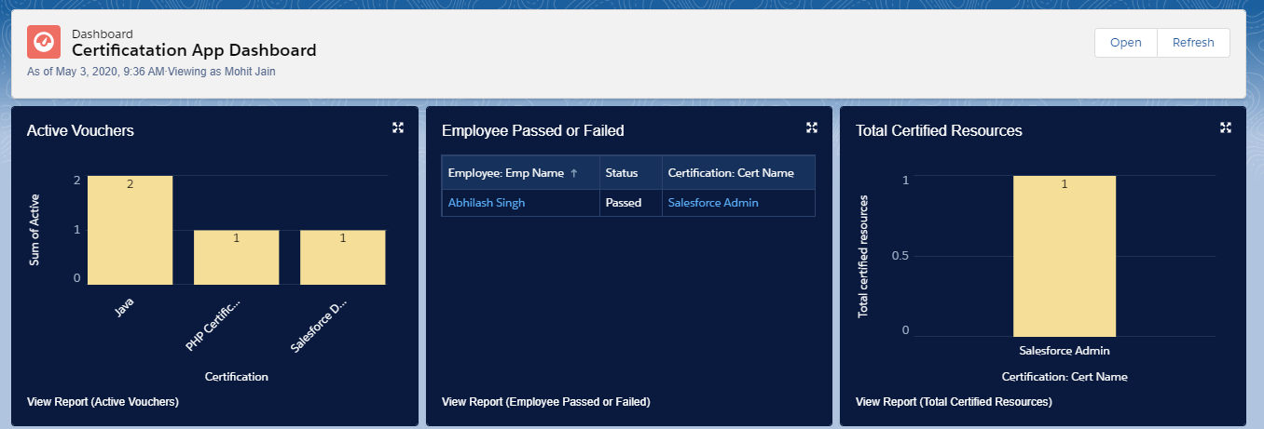
Reports and Dashboards
In this application, 3 reports are implemented:
Active Vouchers (for no. of active vouchers certification wise)
Employee Passed or Failed (for employees passed or failed certification wise)
Total Certified Reources (for total no. of employees who have passed a particular certification exam)
All the 3 reports are shown in the above figure

Slide 11
Validations:
The following validation rules are applied to maintain the consistency of the application:
App User should not be able to raise same certification voucher request again if one already exist in the system.
App User should not be able to add new certification voucher request in system if there is any pending request exist for that employee.
Voucher Validity should be greater than today (the date is stored in the database).
Request Due date should not be less than Today (the date is stored in the database).
A Voucher should be Active for it to be applied.
If a request has been approved and has no voucher, but a voucher is available, then it should be automatically applied.
If an employee gets passed/failed in any certification then system should not allow to App User to raise same certification request for that employee again.

Slide 12


